Slide 1
Multi-Database Synchronization System
多数据库同步系统
学生: 罗达
专业班级: 2308
学号: L208230733
学院：计算机学院

Slide 2
Project Background 项目背景
Project Background 项目背景
With the rapid development of information technology, enterprises often need to use multiple different database systems to meet various business requirements.
随着信息技术的快速发展，企业常常需要使用多种不同的数据库系统来满足不同的业务需求。
This project aims to design and implement a multi-database synchronization system that enables real-time data synchronization across different database platforms while ensuring data consistency and security.
本项目旨在设计和实现一个多数据库同步系统，能够在不同的数据库平台之间实现实时数据同步，同时确保数据的一致性和安全性。
Enterprises rely on multiple database systems
Data inconsistency caused by distributed environments
Manual synchronization is inefficient
企业依赖多数据库系统
分布式环境导致数据不一致
人工同步效率低

Slide 3
Project Objectives 项目目标
Support three databases synchronization
Achieve real-time and scheduled synchronization mechanisms
Conflict detection & email notification
Web-based management interface
Ensure data security and system stability
支持三数据库同步
实时与定时同步
冲突检测与邮件通知
确保数据安全和系统稳定性

Slide 4
System Architecture
系统架构
1. Presentation Layer
User interaction and data visualization
Web dashboard and administrative interfaces
Mobile or responsive access support
2. Application Layer
Request handling and business logic processing
RESTful API services
Authentication and authorization
Coordination with the synchronization engine
3. Synchronization Engine
Real-time data synchronization
Scheduled (periodic) synchronization
Conflict detection and resolution
Data consistency assurance
4. Data & Notification Layer
Central and distributed data storage
Multi-database support
System status notifications and alerts
The system adopts a layered architecture to ensure modularity, scalability, and maintainability. The overall architecture is divided into four main layers…
本系统采用分层架构设计，以提高系
统的可维护性, 可扩展性和稳定性。
整体架构主要分为表示层, 应用层、同步引擎层以及数据与通知层。
各层职责清晰，通过标准化接口进行交互。

Slide 5
Synchronization Engine 同步引擎
The Synchronization Engine is responsible for maintaining data consistency across multiple databases. It supports both real-time synchronization and scheduled synchronization, ensuring that data changes are propagated reliably.
Core system module 系统核心模块，保证一致性
Real-time synchronization
Scheduled synchronization
Incremental synchronization
Conflict detection and resolution
同步引擎层是系统的核心功能模块，负责多数据库之间的数据同步，支持实时同步与定时同步，并具备冲突检测与处理能力。

Slide 6
Database Design 数据库设计
Entity Analysis and Relationship Identification
实体分析与关系识别
Based on the system’s business requirements, including library management, borrowing records, and multi-database synchronization, the following core entities are identified:
Each entity is assigned a primary key (PK) to uniquely identify records, and foreign keys (FK) are used to establish relationships between entities, ensuring referential integrity.
User（用户）：表示系统用户及其基于角色的权限控制。
Author（作者）：存储图书作者的相关信息。
Section（分区）：表示图书馆中的分类或存放区域。
Book（图书）：表示图书及其物理或逻辑属性。
BorrowRecord（借阅记录）：记录图书的借阅与归还信息。
SyncMetadata（同步元数据）：记录系统同步活动及状态信息。
DataConflict（数据冲突）：记录同步过程中检测到的数据冲突及其解决情况。
Normalization Analysis 规范化分析
Normalized to 1NF, 2NF , 3NF/BCNF- Boyce–Codd Normal Form

Slide 7
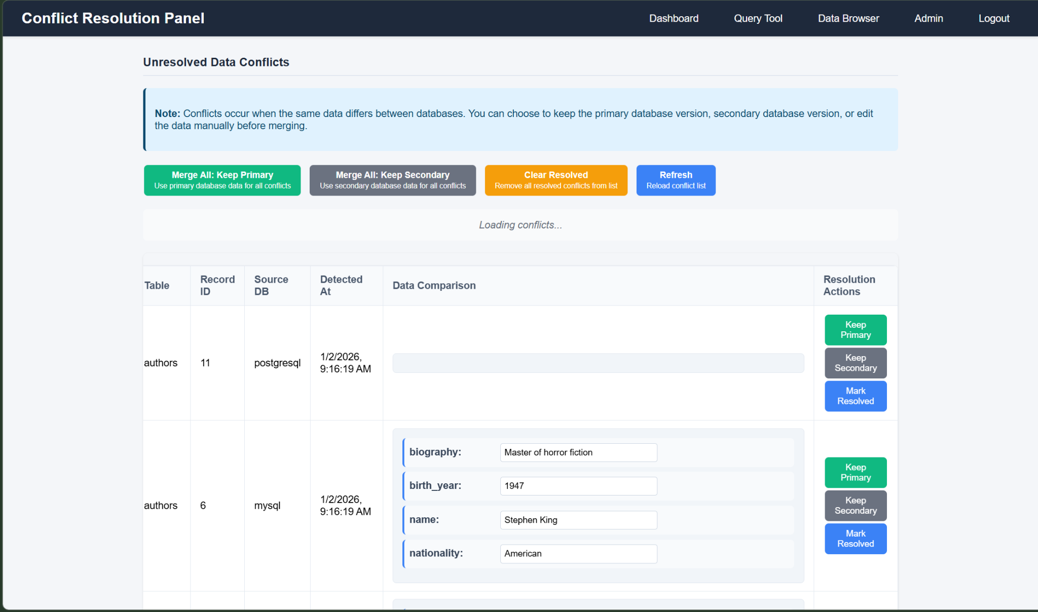
Conflict Management 冲突管理
Conflict Types 冲突类型
Data Mismatch: Different values for same record
Missing Records: Record exists in one DB but not another
Structural Conflicts: Schema differences
数据不匹配: 相同记录的不同值
缺失记录: 记录存在于一个数据库但不在另一个
结构冲突: 模式差异
2. Resolution Strategies 解决策略
Keep Primary: Use primary database data
Keep Secondary: Use secondary database data
Custom Merge: Manual data editing
保留主数据库: 使用主数据库数据
保留次数据库: 使用次数据库数据
自定义合并: 手动数据编辑

Slide 8
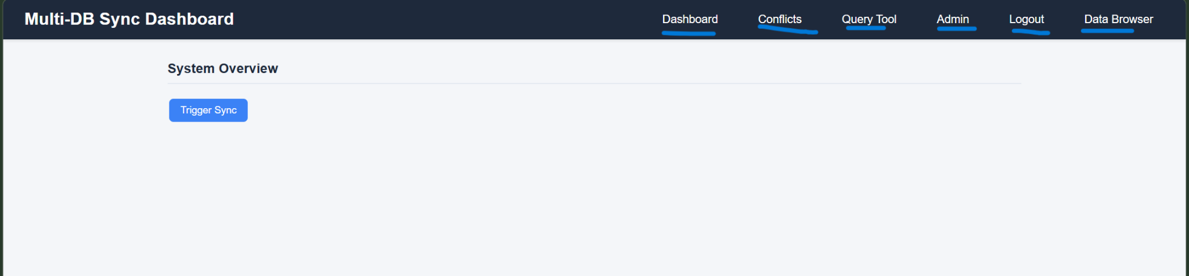
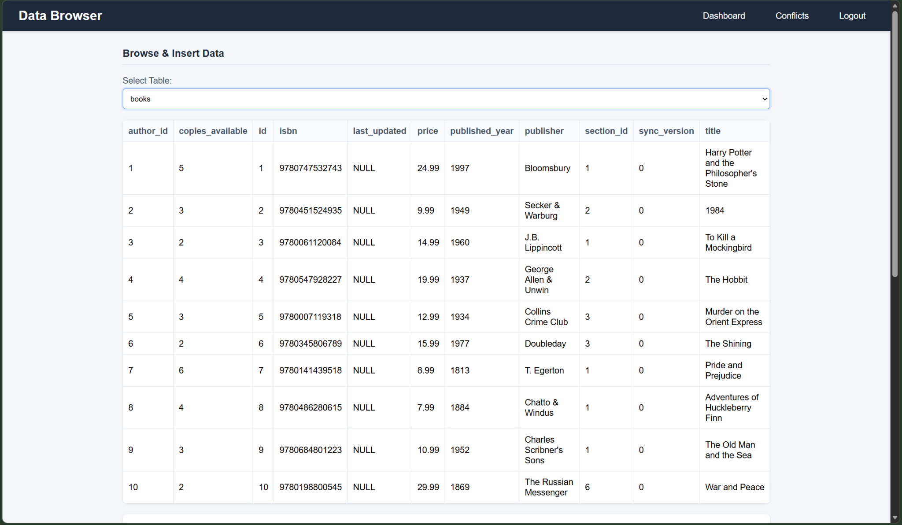
Web Interface Implementation
界面实现
Web界面
Dashboard 仪表板
Real-time synchronization status display
Conflict statistics visualization
System performance metrics
Data browser and editor
实时同步状态显示
冲突统计可视化
系统性能指标
数据浏览

Slide 9
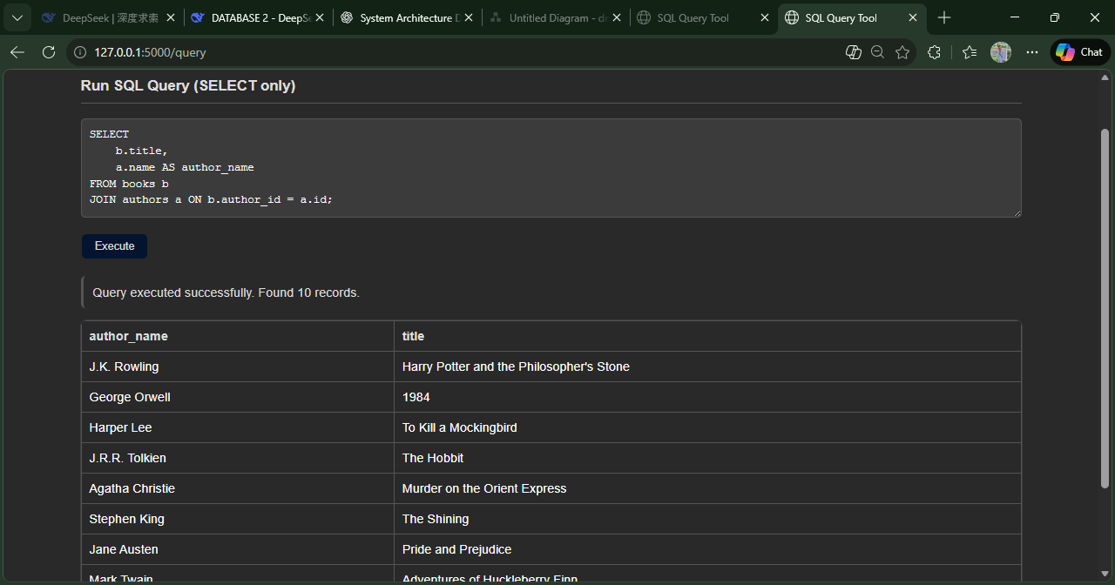
Security & Performance 安全与性能
Performance Optimization 性能优化
1. Query Optimization 查询优化
1.1. Index Design 索引设计
Multi-table join with aggregation
1️. Query: List all books with their authors
1 Authentication 身份验证
python
@login_manager.user_loader
def load_user(user_id):
return User.query.get(int(user_id))
def admin_required(f):
@wraps(f)
@login_required
def wrapper(*args, **kwargs):
if current_user.role != "admin":
abort(403)
return f(*args, **kwargs)
return wrapper
2 API Security API安全
Token-based authentication for mobile access
Input validation and sanitization
Rate limiting on sensitive endpoints
移动端基于令牌的身份验证
输入验证和清理
敏感端点的速率限制

Slide 10
Testing Results 测试结果
1 Test Cases 测试用例
1.1 Synchronization Tests 同步测试
Basic Sync Test: Verify data propagates correctly
Conflict Detection Test: Ensure conflicts are identified
Email Notification Test: Confirm emails are sent
Performance Test: Measure sync speed under load
基本同步测试: 验证数据正确传播
冲突检测测试: 确保冲突被识别
邮件通知测试: 确认邮件发送
性能测试: 测量负载下的同步速度
1.2 Security Tests 安全测试
Authentication Test: Verify login functionality
Authorization Test: Check role-based access control
Input Validation Test: Test for SQL injection prevention
身份验证测试: 验证登录功能
授权测试: 检查基于角色的访问控制
输入验证测试: 测试SQL注入防护
2. Test Results 测试结果 │
Test Case: Real-time Sync
Status: PASS
Result: Data synchronized within 1 second
Test Case: Conflict Detection
Status: PASS
Result: 7 conflicts detected correctly
Test Case: Email Notification
Status: PASS
Result: Email sent successfully
Test Case: Web Interface
Status: PASS
Result: All pages load correctly
Test Case: Mobile Access
Status: PASS
Result: Responsive design works

Slide 11
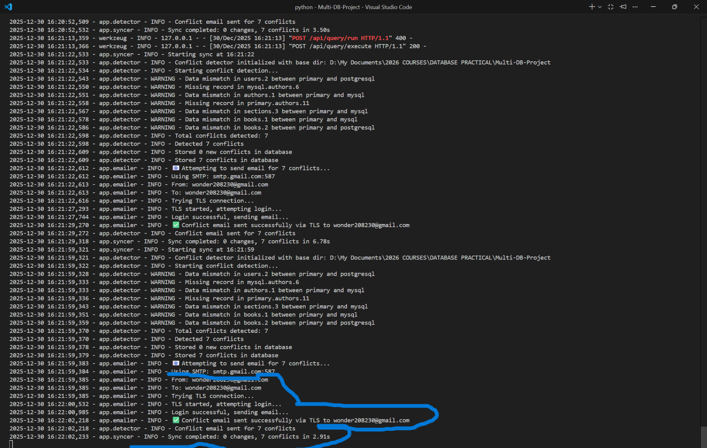

Slide 12
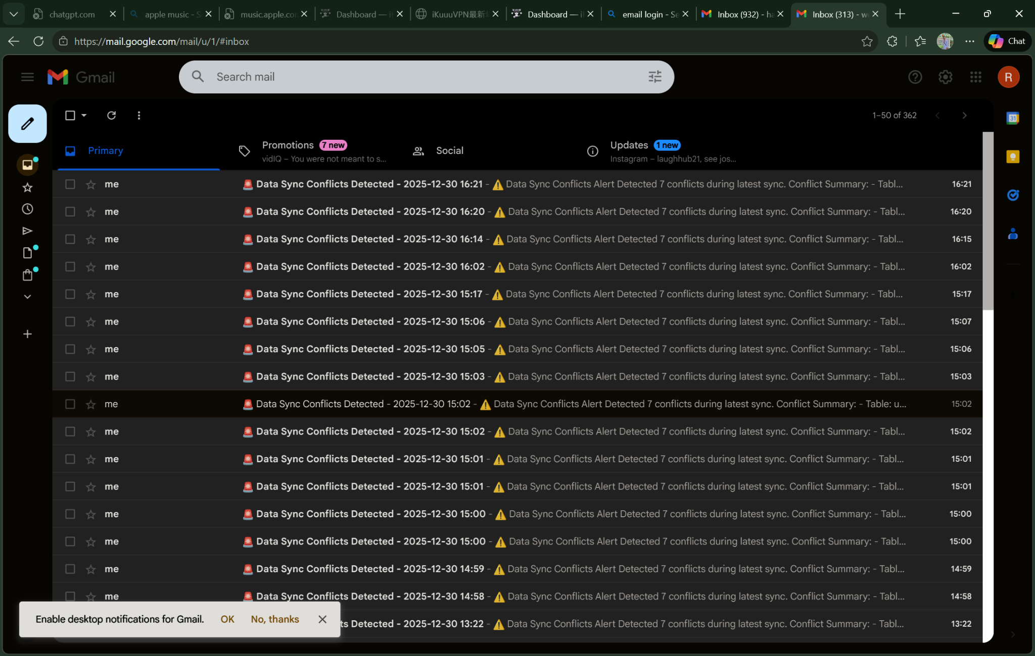
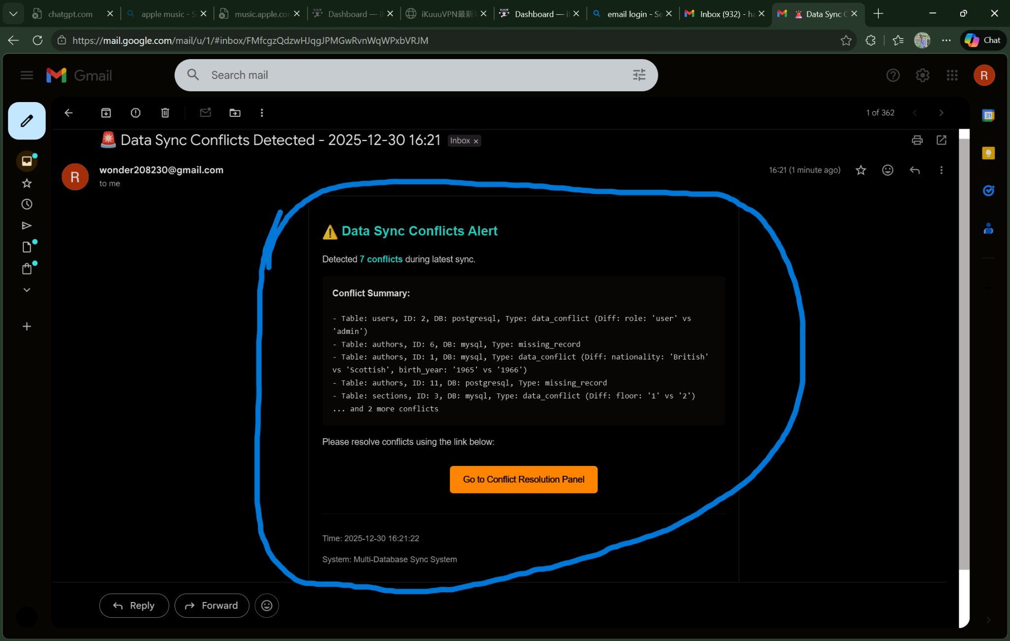

Slide 13
Challenges and Solutions 挑战与解决方案
1 Technical Challenges 技术挑战
1.1 Database Compatibility 数据库兼容性
Challenge: Different SQL dialects and feature sets Solution: Use SQLAlchemy ORM for abstraction
挑战: 不同的SQL方言和功能集 解决方案: 使用SQLAlchemy ORM进行抽象
1.2 Real-time Synchronization 实时同步
Challenge: Ensuring immediate data propagation Solution: Thread-based monitoring with configurable intervals
挑战: 确保即时数据传播 解决方案: 基于线程的监控，可配置间隔
Conflict Resolution 冲突解决
Challenge: Determining authoritative data source Solution: Configurable resolution strategies with admin override
挑战: 确定权威数据源 解决方案: 可配置的解决策略，管理员可覆盖
2 Implementation Insights 实现见解
2.1 Architecture Decisions 架构决策
Modular Design: Separate components for easy maintenance
Plugin Architecture: Extensible for additional database types
Logging System: Comprehensive audit trail
模块化设计: 分离组件便于维护
插件架构: 可扩展以支持更多数据库类型
日志系统: 全面的审计跟踪
2.2 Performance Considerations 性能考虑
Batch Processing: Reduce database round trips
Caching: Frequently accessed data caching
Connection Management: Efficient resource utilization
批量处理: 减少数据库往返次数
缓存: 频繁访问数据缓存
连接管理: 高效资源利用

Slide 14
Conclusion and Future Work
总结与展望
This project successfully designed and implemented a multi-database synchronization system supporting real-time and scheduled synchronization across multiple databases. Key achievements include automated conflict detection and resolution, secure user authentication, web and mobile access, and email-based notifications, demonstrating strong system reliability and usability.
Technically, the system achieves robust synchronization logic, effective error handling, and comprehensive testing, ensuring data consistency and system stability.
Future work will focus on supporting additional databases (e.g., MongoDB, Redis), intelligent conflict resolution using machine learning, enhanced monitoring dashboards, API extensions, and mobile application development, along with further performance optimization and scalability improvements.
本项目成功实现了一个支持多数据库的同步系统，具备实时与定时同步、冲突自动检测与解决、安全认证、Web与移动访问以及邮件通知功能，系统稳定且可靠。
未来将进一步扩展数据库类型支持，引入基于机器学习的冲突处理机制，增强监控与性能优化能力，并开发移动端应用，提升系统的可扩展性与智能化水平。

